Slide 1
Memory Management Design Issues for Paging Systems

Slide 2
Review
Memory Manager
coordinate how the different types of memory are used
keep track memory to allocate and release areas of main memory to processes
manage swapping between main memory and disk
No Memory Abstractions
Single program
One OS, only one process
Special register is used to protection between OS and process
Disadvantages: slow
Multiple program
One OS, many processes locate in memory
Divided into fixed size block
Disadvantages
Internal fragmentations
Two programs both reference absolute physical memory → static relocation

Slide 3
Review
Memory Abstractions
Multiple processes locate in memory (both primary and secondary)
Base and Limit Registers
Multiple processes locate in memory and protection
Base contains the first address of process in memory, Limit contains the length of process, the process owns private address space
Disadvantages
External fragmentation (Defragment)
Slow
Swapping
Multiple processes with ready processes locate in memory and passive processes locate in HDD – swap file area
Swap out/ in operator
Disadvantages
External fragmentation
Process can not grow in memory and the swap area on the disk is full → data segment upward, stack segment downward

Slide 4
Review
Memory Abstractions
Memory Management with Bitmaps
The memory divides units with same size that has a bit corresponding bit in the bitmap (0: free, 1: occupied)
Disadvantages
Slow when searching the bitmap to find a run of k consecutive 0 bits in the map (small)
External fragment (large size)
Memory Management with Linked Lists
Maintain a linked list of allocated (P) and free memory (H)
Allocating algorithms
First, Next, Best, Worst, Quick Fit
Virtual Memory
Software/ Process sizes larger than memory
Overlays
Developer splits program to many overlays
Disadvantages: developer‘s knowledge is important

Slide 5
Review
Memory Abstractions
Virtual Memory
Paging
Address space is broken up into pages
Physical memory is divided up into page frames
Virtual address vs. Physical address, manage address space with bit
MMU transfers Virtual address → p, d; then it looks up page table following the index to get the page frame; the page frame combines with d to determine the physical address
Page fault: the program references a part of its address space that is not in physical memory
Page table
Load to collection registers, load to memory using base register, using TLB
Excessive large page table: multilevel page, inverted page table, inverted page table with hash or TLB
Entry: Caching disabled, Referenced, Modified, Protection, Present/absent, page frame number

Slide 6
Review
Memory Abstractions
Virtual Memory
Paging
Page replace algorithms
Optimal: the page will be the latest one accessed in the future
NRU: the page has lowest class that combines R and M bit
FIFO: the page at the head of queue
Second Chance: old page has not been not referenced in the previous clock interval (R = 0). If R of page equals 1, R is reset to 0 and put the tail of the queue.
Clock (circular queue) : the page being pointed to by the hand is inspected. If R = 0, page is evicted. Otherwise, R is reset to 0, the pointer points next
LRU: the page at the end of the list is replaced, the list must be updated at each memory reference
NFU, Aging (using bit): The page with the lowest counter
Working set model, working set clock (circular queue): Third Chance with Second Chance using age > τ with bit R
Terminology: Thrashing, Locality of Reference, Demand paging, prepaging, working set, page fault rate

Slide 7
Objectives
Design Issues for Paging Systems
Local vs. Global Allocation Policies
Load Control
Page Size
Shared Pages
Shared Libraries
Mapped Files Ánh xạ
Cleaning Policy
Virtual Memory Interface

Slide 8
Local vs. Global Allocation Policies
Design Issues for Paging System
The context
Page fault
Page replacement
Question: should the page replacement algorithms try to find LRU page consider only the page currently allocated to particular process, or should it consider all the pages in memory?
Local: pages of the current process
Global: pages of all processes
Answer: depends on the strategy used to allocate memory between the competing runnable processes
Local: Every process has a fixed fraction of memory allocated (advantages)
Global: page frames are dynamically allocated among runnable processes
Local algorithms
The working set grows → thrashing
The working set shrinks → waste of memory

Slide 9
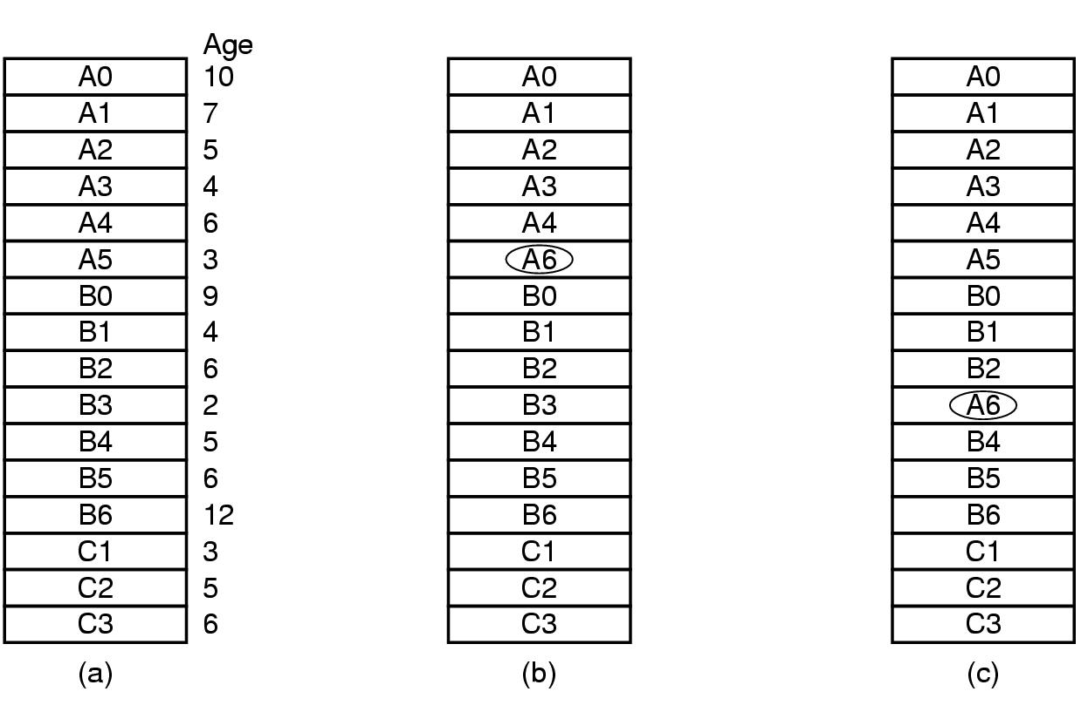
Design Issues for Paging System
Local vs. Global Allocation Policies
A6 causes the page fault
Local
Global
Tanenbaum, Fig. 3-23.

Slide 10
Design Issues for Paging System
Local vs. Global Allocation Policies
Global algorithms
Work better, especially when the working set size can vary over the lifetime of a process
The thrashing va đập (máy lag) can occurs to other processes of which pages are chosen to replace → the other processes can not control the page fault rate
The working set size is smaller → waste of memory
Strategies for the system must continually decide how many page frames to assign to each process
Monitor the size of working set of all processes
Based on the aging bits of pages (does not necessarily prevent thrashing)
Page frames allocation algorithm
To periodically determine the number of running processes
Allocate pages proportionally with each process size
Give each process a minimum number of frames
The allocation is updated dynamically
The PFF (Page Fault Frequency) algorithm (Count the page number of faults per second)
Some page replacement algorithms
Can work with both policies (FIFO, LRU)
Can work only with the local policy (WSCLock)

Slide 11
Design Issues for Paging System
Local vs. Global Allocation Policies – Example
Assume that process A-D make up the set of runnable processes on memory as
B1 B2 B3 A1 A2 A5 A7 D3 D4 D6 C1 C6 C5.
Suppose that D gets a page fault.
Which page is replaced using the local policy? Assume that the replaced page is always a last page.
D6
Which page is replaced using the global policy? Assume that the replaced page is always applied to process taking most pages(số nhiều nhất).
A7

Slide 12
Design Issues for Paging System
Load Control
Context
The system thrashes can occurs even if the best page replacement algorithm and optimal global allocation of page frames is used
When the combined working sets(tập các Page chạy đồng thời)of all processes exceed the capacity of memory → thrashing
PFF algorithm indicates that some processes need more memory but no process need less memory
→ no way to give more memory to those processes needing it without hurting some other processes
A good way to reduce the number of processing competing for memory is to swap out some processes and free up all the pages they are holding to divide those pages up to thrashing processes
Keep the page-fault rate acceptable (periodically, some processes are swapped in and other ones are swapped out)
Take into account the degree of multiprogramming
Considering not only process size and paging rate when deciding which process to swap out, but also its characteristics (CPU or I/O bound)

Slide 13
Design Issues for Paging System
Page Size
Is often a parameter that can be chosen by the OS
Determining the best page size requires balancing several competing factors (there is no overall optimum)
Argue for small size
Internal fragmentation (n = segments in memory, p = bytes of a page size → internal fragment is np/2 bytes)
Need many pages → the page table is large and transferring takes more time
Argue for large size
Cause more unused program to be in memory than a small size
Transferring takes less time than small size
Analyzed mathematically
s = average process size in bytes, p = page size in bytes
→ s/p = approximate number of pages needed per process
e = number of bytes per page table entry
→ overhead of memory for a process = se/p + p/2, due to page table size and internal fragmentation
optimum is found equating the first derivative to 0 → -se/p² + ½ = 0

Slide 14
Design Issues for Paging System
Page Size
Memory
Fragment
Page table
1 | …
2 | …
3 | ….

Slide 15
Design Issues for Paging System
Separate Instruction and Data Spaces
Problems
Most computers have a single address space that holds both programs and data
If that address space is often too small, forcing programmer to stand on their heads to fit everything into the address space
Solutions
Separate address spaces for
Instructions (I-space)
Data (D-space)
Each address space runs from 0 to maximum
The linker and the hardware must know when separate spaces are being used
Both address spaces can be paged, independently and have its own page table (mapping virtual pages to physical page frames)
Practically is double the available address space

Slide 16
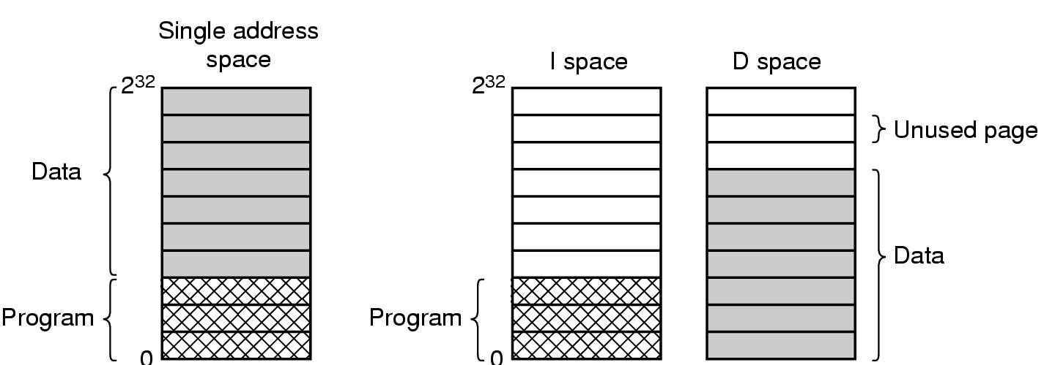
Design Issues for Paging System
Separate Instruction and Data Spaces
Tanenbaum, Fig. 3-25.

Slide 17
Design Issues for Paging System
Shared Pages
Problem
In large multiprogramming system, it is common for several users to be running the same program at the same time
Having two copies of the same page in memory at the same time
Solution
Share the read only pages (code can be shared but data cannot)
If separate spaces are supported, two or more processes use same their I-Space but different their D-Space. Implementing
Page tables are data structures independent of the process table
Each process has two pointers in process table: one to the I-space and one to the D-space
Problems: Both A & B processes running the editor & sharing pages
The scheduler decides to remove A to from memory, evicting all its pages and filling the empty page frames with some other program will cause B generate a large number of page faults to bring them back in again
Similar, A terminates, scheduler discover the pages still in used (not removed) → implement the data structure to keep track of shared pages to reduce the searching (since searching is expensive)

Slide 18
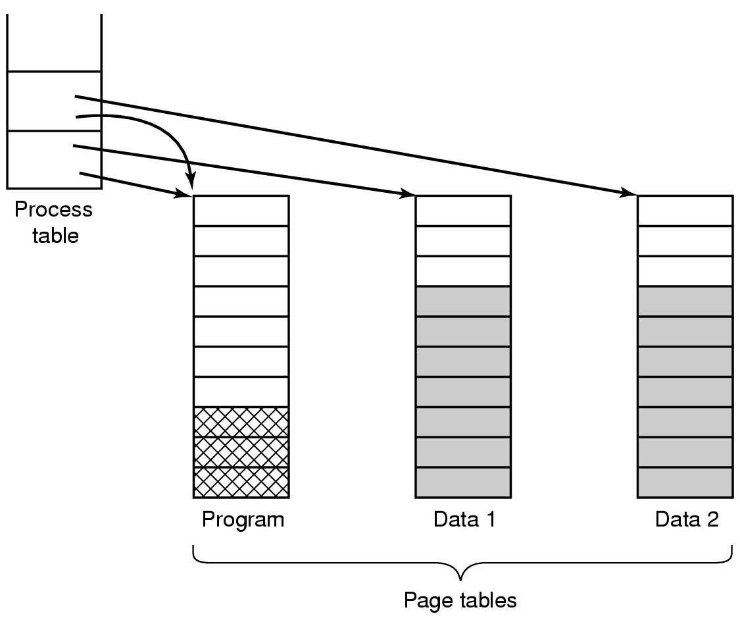
Design Issues for Paging System
Shared Pages
Tanenbaum, Fig. 3-26.

Slide 19
Design Issues for Paging System
Shared Pages
Sharing data (modifiable pages)
Context
The parent and child processes to initially share the same pages
Data can be shared and can be modified concurrently by many processes
Ex:
The child process attempt to modified a page containing portion of stack
The OS recognizes that the page may be shared and can be modified (by both processes), the OS will create a copy of this page and map it to the address space of the child process
The process will modify its copied page and not the page belonging to the parent process
→Above example is the copy-on-write strategy solution
If either process writes to a shared page (that can be modified), a copy of shared page is created
Only the pages that are modified by either process are copied; all non-modified pages may be shared by the parent and the child processes
This solution is applied to the OS using the duplicating process strategies
Ex: Windows 2000, Linux, Solaris 2

Slide 20
Design Issues for Paging System
Problems
In modern system, there are many libraries used by many process
Statically binding all these libraries to every executable program on the disk would make them even more bloated
Solutions: using Share libraries
Ex: DLL – Dynamic Link Libraries
A program linked with a share libraries, instead of including the actual function called, the linker includes a small stub routine that binds to the called function at the run time
Shared libraries is only loaded either when the program is loaded or when functions in them are called for the first time
The entire libraries is not read into memory, it is paged in, page by page, as needed, so functions that are not called will not be brought into RAM
Advantages
Making executable file is smaller and saving space in memory
If function in a shared library is updated to remove a bug, it is not necessary to recompile the programs that call it. The old binaries continue to work
Shared Libraries

Slide 21
Design Issues for Paging System
Shared Libraries
Problems
Two processes uses the shared library at a different address in each process
Each process and shared library are located at the different addresses
Therefore, some functions may be gone to the different absolute addresses in the shared library
→ The reference address will not be moved in exactly because the relocation on the fly will not work with using the shared libraries
→ The absolute address cannot be applied with using shared libraries
Solution
First Approach: Using copy-on-write
This will create new pages and relocate them on the fly in correctly for each process in creating progress
→ This is not the shared solution because this solution copies the non-modified pages
Second Approach: using position-independent-code
The instruction in code should used only relative offsets then the absolute addresses
This is word correctly with the shared libraries placing anywhere in virtual address space

Slide 22
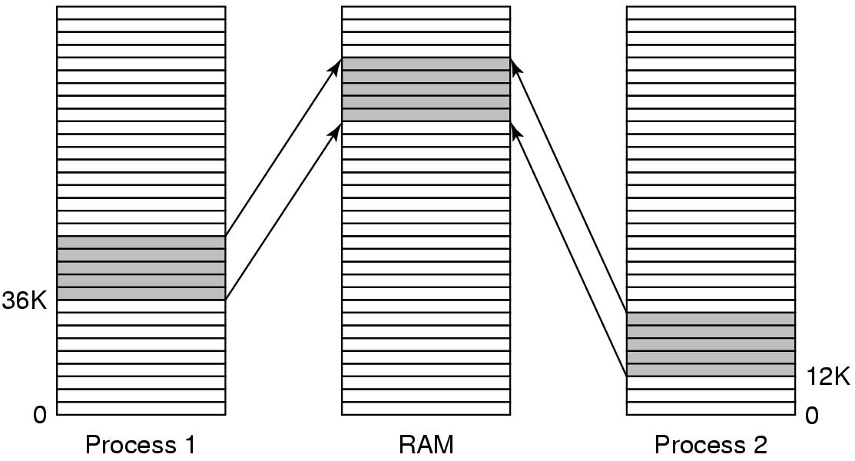
Design Issues for Paging System Shared Libraries
Tanenbaum, Fig. 3-27.

Slide 23
Design Issues for Paging System
Memory-Mapped Files
Context
Manipulating a file on disk must be invoked the system call open(), read() and write() and must access the disk → slow
Virtual memory
Memory Mapped File
Treat file I/O as routine memory access
Allowing a part of the virtual address space to be logically associated with the file
Map a disk block to a page (s) in memory and page used the file on disk as the backing store
→ faster and simplifier
How does it work
Initial, when the file is accessed, the page fault is occurs
Then, the pages are allocated and are loaded the content from file system
Subsequent, the file manipulations are handled as routine memory accesses
It is not necessarily be immediate writes file to disk when the memory is modified. Instead of this, the OS updates the file on disk in periodically if any if the memory has been modified
When the process exits (e.g. file is closed), all the modified pages are written back to the file

Slide 24
Design Issues for Paging System
Memory-Mapped Files
In practically,
Some OS using this solution only through a specific system call (ex: mmap() in Solaris 2) and treat all other file I/O using the standard system calls
If two processes map onto the same file at the same time, they can communicated over shared memory
One process writing done to the share memory are immediately visible when the others one reads (sharing data and support to copy-on-write) → Provide high bandwidth channel between process
Shared libraries can used this mechanism, if memory-mapped file is available

Slide 25
Design Issues for Paging System Cleaning Policy
Paging daemon
A background process sleeps most of time but is awakened periodically to inspect the state of memory
Ensure a plentiful of free page frame to paging works best
If too few page frames are free, the paging daemon begins selecting pages to evict using some page replacement algorithm, then written them to disk (if it is modified)
Requirement
The previous contents of page are remembered
All the free frames are clean, so the written to disk in a big hurry does not occur
Cleaning policy
Using two-handed clock
Front hand is controlled by the paging daemon. When it points to a dirty page, that page is written back to disk and the front hand is advanced. Otherwise, it is just advanced
Back hand is used for page replacement algorithm as in the standard clock algorithm

Slide 26
Design Issues for Paging System Virtual Memory Interface
Context
The large virtual address space can be mapped with a smaller physical memory
A programmer can controls over their memory map to allow many processes to share memory
Share memory
Programmer can name regions of their memory
Then, the name of a memory regions can be shared to many processes
→ The page in memory can be shared to many processes
→ The shared memory region is used to write by one process and read from another process (pipe mechanism, IPC)
→ high bandwidth, enhance the program’s progress

Slide 27
Design Issues for Paging System Virtual Memory Interface
In message passing system,
Problem: when messages are passed, the data are copied from one address space to another → complexity and waste time
Solution:
Share memory is applied by copying the page names instead of all the data
The sender unmaps the pages containing the message when the message are passed
Then, the receiving maps the unmapped pages in (only page names have to be copied)
→ high performance
In distributed application,
When a process references a page that is not mapped in, the page fault occurs
The page fault handler locates the machine holding the page and sends it a message asking it to unmap the page and send it over the network
When the page arrives, it is mapped in and the fault instruction is restarted
→ Allow multiple process over a network to share a set of pages (high performance)

Slide 28
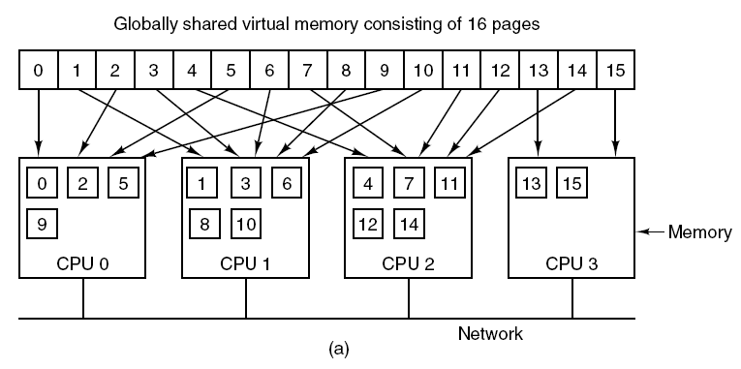
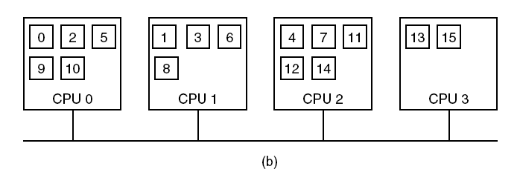
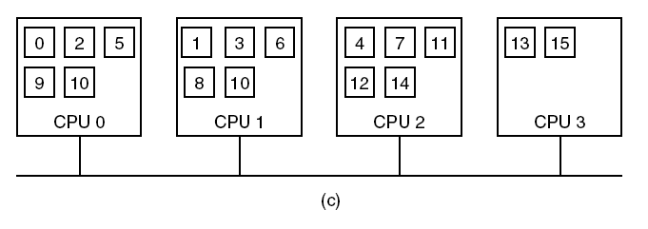
Design Issues for Paging System Virtual Memory Interface

Slide 29
Summary
Design Issues for Paging Systems
Q&A

Slide 30
Next Lecture
Implementation the Paging Systems Issues
Segmentation
Combine the paging with managing memory
Case Studies: Intel and MUTICS

